Slide 1
Finding a Night Club Location in new YoRk
In the time of COVID using Data Science Techniques

Slide 2
Motivation

Slide 3
Data Acquisition and Cleaning
New York neighborhood data from Coursera assignment:
https://geo.nyu.edu/catalog/nyu_2451_34572
306 entries having latitude and longitude of geographical centers of neighborhoods
New York boundary data from geo json file:
https://github.com/veltman/snd3/blob/master/data/nyc-neighborhoods.geo.json
188 entries having the geographical boundaries of neighborhoods as polygons
Some neighborhoods were combined into single polygons
Foursquare API used to get Night Clubs based on distance from geographical centers of neighborhoods

Slide 4
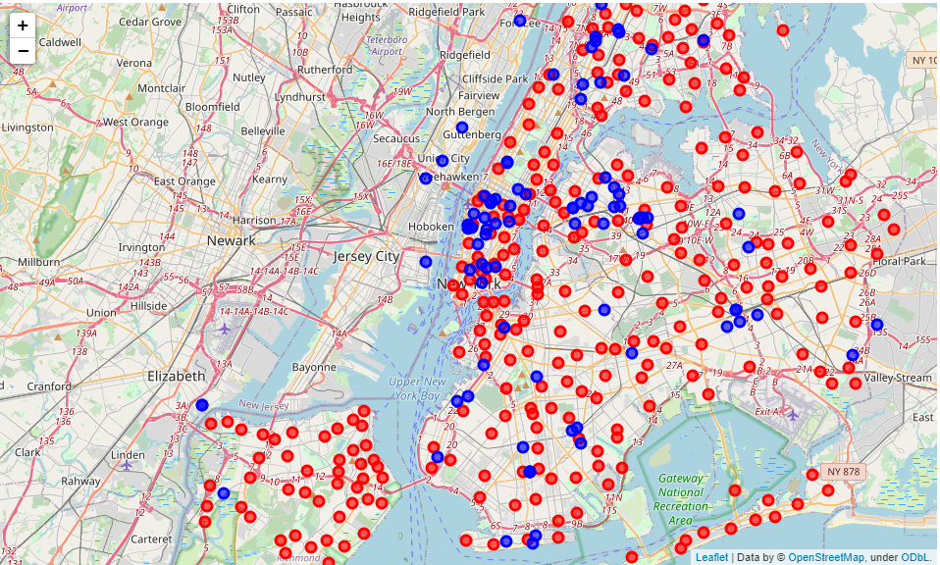
Club Locations and Neighborhood centers

Slide 5
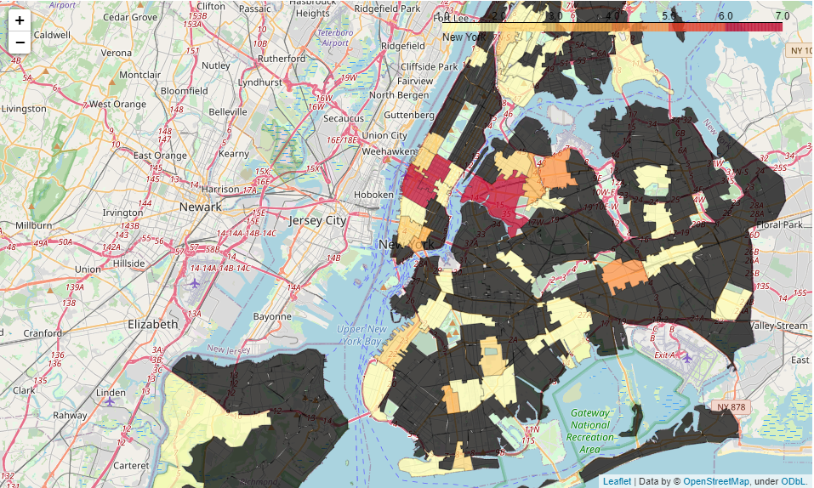
Binning Clubs Geographically

Slide 6
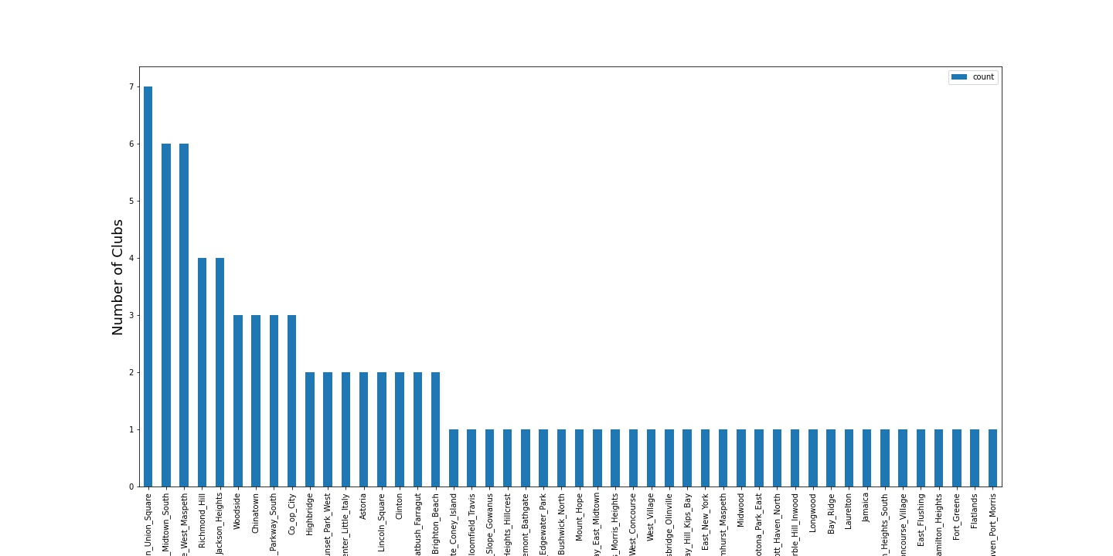
Ranking the Top Neighborhoods

Slide 7
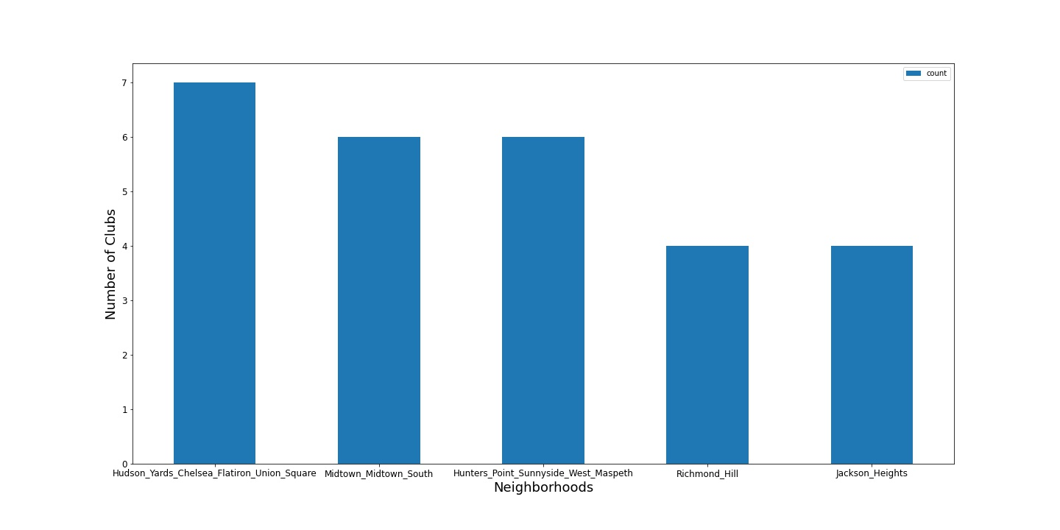
Five Neighborhoods with the most clubs

Slide 8
Limitations Because of Covid-19
Many clubs in New York at this time are closed
Many clubs didn’t have foursquare IDs to pull additional information
Rating information was not available on all Night Clubs because of the closing
Any club that did not have a rating was assigned a penalty of -1.
Any areas with many closed clubs would have a large penalty
The assumption is it’s better to open a club any club in an area with other open clubs instead of an area with no clubs.
That is some night life is better than no night life

Slide 9
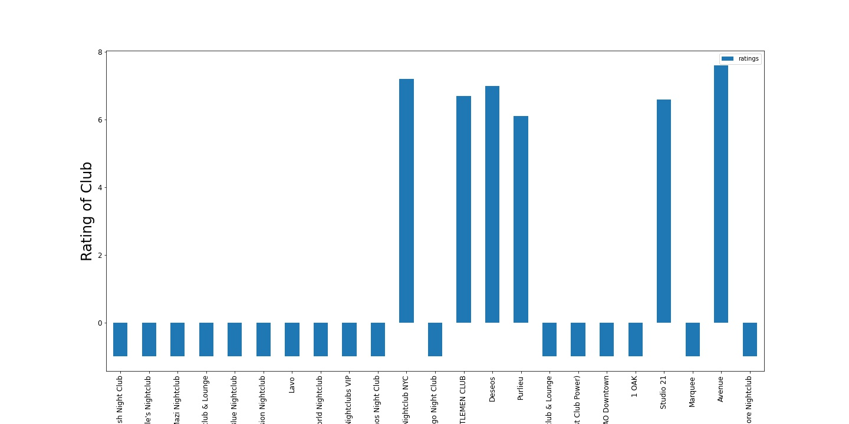
Adding the Average Club Rating

Slide 10
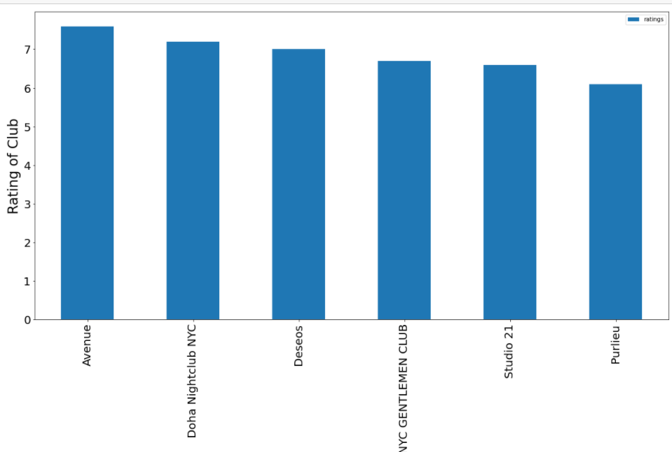
Plotting the Only clubs that have a Rating

Slide 11
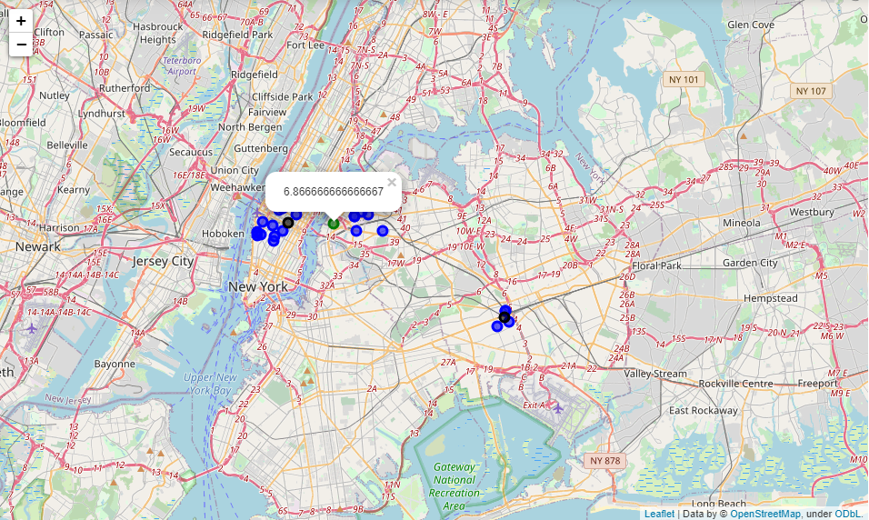
Clustering by Location and Rating
K-means Clustering
3 centroids

Slide 12
Picking the best Neighborhood
Using K-means clustering
Three distinct clusters were used
The average rating produced for each cluster was compared.
Only 1 cluster had a positive rating
It also contained the most clubs with positive ratings
The neighborhood seemed more resilient to a downturn in the economy due to covid. More open clubs mean that location is fairing better.

Slide 13
Conclusion and Future Directions

